Slide 1
JAVA ASSIGNMENT
STUDENT DATABASE MANAGEMENT

Slide 2
Problem Explanation
To develop a student database by implementing three classes such as Student, Details, Cgpa.

Slide 3
Usage of Concepts
Interface
Inheritance
Packages
Constructor
Classes and methods
Object

Slide 4
Interface
Interface is used to implement the abstraction and multiple inheritance. Interface named getable and printable is used in which two methods are declared such as
void getinfo();
void display();

Slide 5
Interface getable
Interface printable
Class Details

Slide 6
Class
There are three classes in this program such as Student, Details and Cgpa. Three classes are present in the same package called project.
The class Details achieves multiple inheritance by implementing the interface getable and printable.
In the class details ,all the methods that are declared in the interface getable and printable are implemented.

Slide 7
In the class Student the main method is declared in which object is created and the call to the class Cgpa is executed.
In the class Details ,the student details from the user is got using the Scanner class.

Slide 8
Package
The package is used to group the closely related classes.
Here package called project is created which contains java file Student.java
It is imported in another java file called pack.java.

Slide 9
Constructor
The constructor for the class Cgpa is created to get the student cgpa from the user.

Slide 10
Inheritance
Single level inheritance is achieved by class Cgpa which extends the class Details .
Class Details
Class Cgpa

Slide 11
METHODS
1.getinfo()
This method is used to get the information of the student from the user.
It is implemented in the class Details and declared in the interface getable.
When a call to the getinfo is invoked by the sub class Cgpa object ,it asks for the student details like name, roll no, dept ,subject marks from the user.

Slide 12
2.display()
This method is used to display the information of the student from the user.
It is implemented in the class Details and declared in the interface printable.

Slide 13
3.calculate()
This method is used to calculate the Cgpa of the student when the constructor of the class Cgpa is invoked.
To calculate the Cgpa, marks from the getinfo and credits from the constructor is used.

Slide 14
OUTPUT

Slide 15
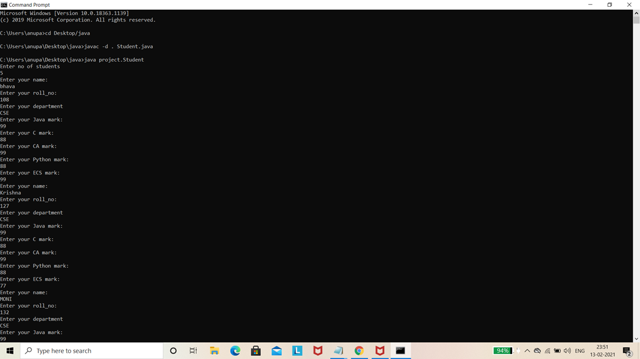

Slide 16
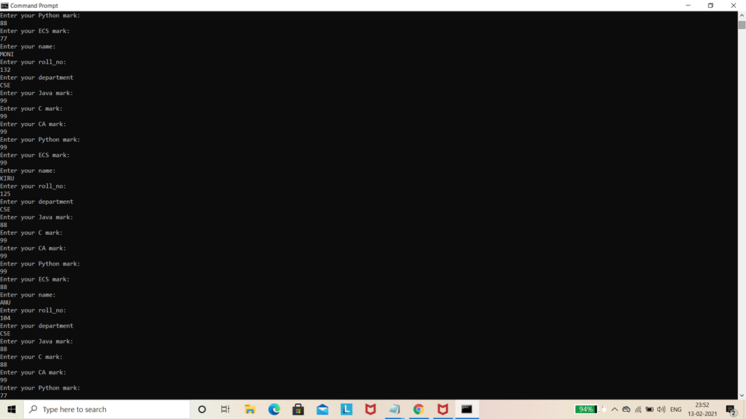

Slide 17
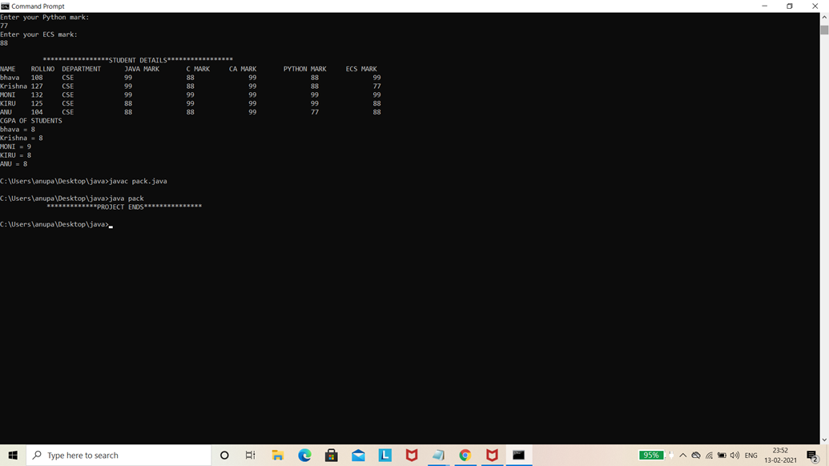

Slide 18
Result
Thus the student database management in java is developed using the interface, inheritance, packages, constructors etc…

Slide 19
Submitted by
Anusuya K – 1817104
Bhavadharani S – 1817108
Krishnapriya C – 1817127
Monisha K - 1817132

Slide 20
THANK YOU

